Slide 1
Shiny Dashboard in R Day 1 Rave Technologies Vasim Shaikh

Slide 2
Dashboard Basics
Everything should be made as simple as possible, but no simpler

Slide 3
SEC 1 - Topics covered
Types of data
Basic types of data
Types of Dashboard
Client-side and server-side dashboard
Basic chart types
Advanced chart types
When to use which chart?
Your audience will listen to you or read the content, but won’t do both.

Slide 4
Types of Data
CATEGORICAL DATA
Examples: Gender, Level
NUMERICAL DATA
Examples: Rating, Age
Categorical |  | Numerical
Gender | Designation | Rating (1-5) | Age
Male | Middle | 4 | 32
Female | Lower | 3 | 25

Slide 5
Basic Data Types (NOIR)
Categorical
Nominal
Ordinal
Numerical
Interval
Ratio
Categorical |  | Numerical
Nominal | Ordinal | Interval | Ratio
Gender (1,0) | Designation (1,2,3) | Rating (1-5) | Age
0 | 3 | 3 | 25
1 | 2 | 4 | 32
Some other types:
Qualitative and Quantitative data
Discrete data and Continous data

Slide 6
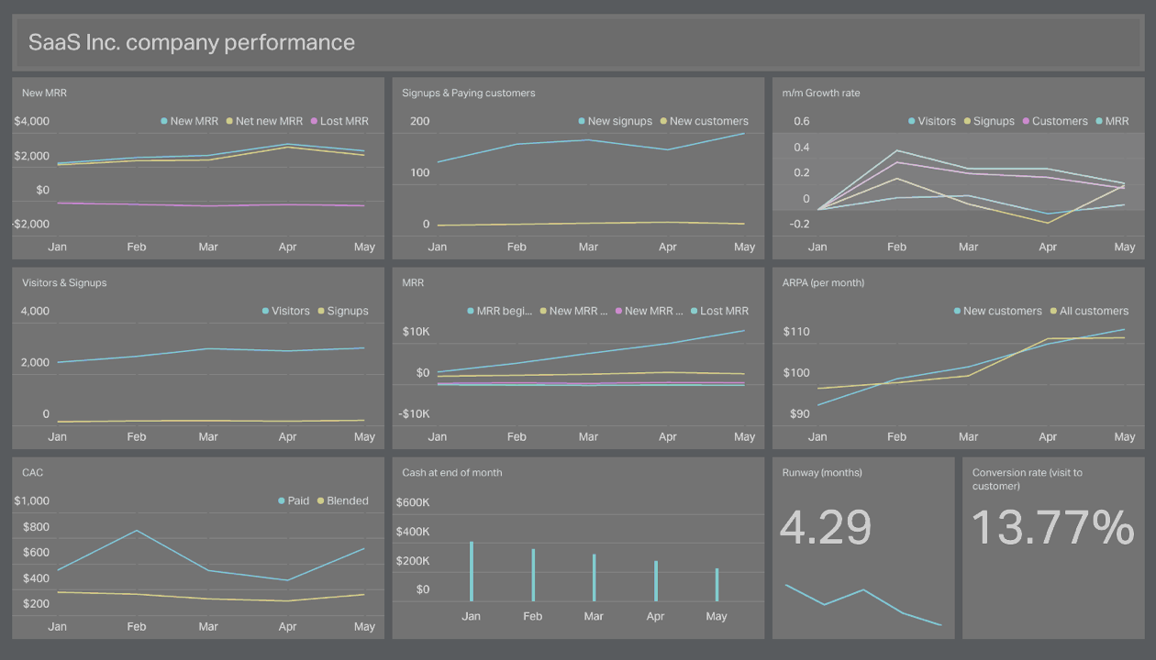
Strategical, Operational & Analytical
Types of Dashboard – Stephen Few

Slide 7
What are they?
Strategical
Used by business executive.
Business snapshot.
Quick overview to decision makers.
Analytical
Used by mid-level manangement (analytics).
Interactions and Drills.
Identify relationship, patterns.
Operational
Used by Operational management.
Fully interactive.
Triggers for measuring deviations

Slide 8
Stephen Few tips

Slide 9
Dashboard
Client Side Dashboard
The client-side environment used to run scripts is usually a browser.
The processing takes place on the end users computer.
The source code is transferred from the web server to the users computer over the internet and run directly in the browser.
Server Side Dashboard
The server-side environment that runs a scripting language is a web server.
A user's request is fulfilled by running a script directly on the web server to generate dynamic HTML pages.
This HTML is then sent to the client browser. It is usually used to provide interactive web sites that interface to databases or other data stores on the server.

Slide 10
Basic Chart types
Yellow
Is the color of gold, butter and ripe lemons. In the spectrum of visible light, yellow is found between green and orange.
Blue
Is the colour of the clear sky and the deep sea. It is located between violet and green on the optical spectrum.
Red
Is the color of blood, and because of this it has historically been associated with sacrifice, danger and courage.
Yellow
Is the color of gold, butter and ripe lemons. In the spectrum of visible light, yellow is found between green and orange.
Blue
Is the colour of the clear sky and the deep sea. It is located between violet and green on the optical spectrum.
Red
Is the color of blood, and because of this it has historically been associated with sacrifice, danger and courage.

Slide 11
Some Advance Chart types
Yellow
Is the color of gold, butter and ripe lemons. In the spectrum of visible light, yellow is found between green and orange.
Blue
Is the colour of the clear sky and the deep sea. It is located between violet and green on the optical spectrum.
Red
Is the color of blood, and because of this it has historically been associated with sacrifice, danger and courage.
Yellow
Is the color of gold, butter and ripe lemons. In the spectrum of visible light, yellow is found between green and orange.
Blue
Is the colour of the clear sky and the deep sea. It is located between violet and green on the optical spectrum.
Red
Is the color of blood, and because of this it has historically been associated with sacrifice, danger and courage.

Slide 12
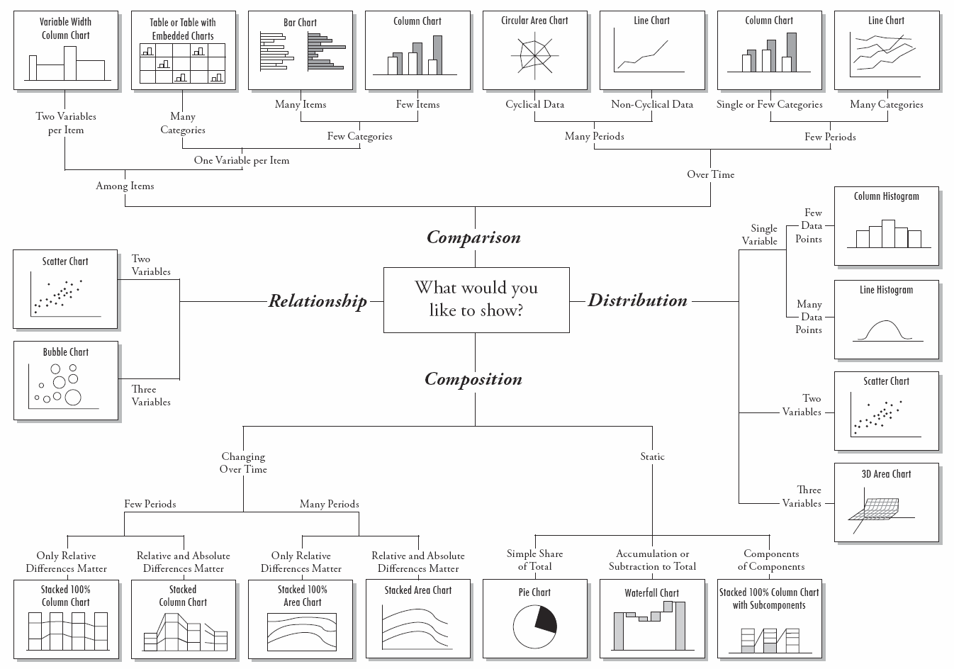

Slide 13
SEC 2 – R Basics
Define variables
Basic R data types
Data classes in R
Data structure in R
Overview of R Studio
R Packages
Basic operations
If Else statement
Looooooop
Piping %>%
Save and Source
Need help?

Slide 14
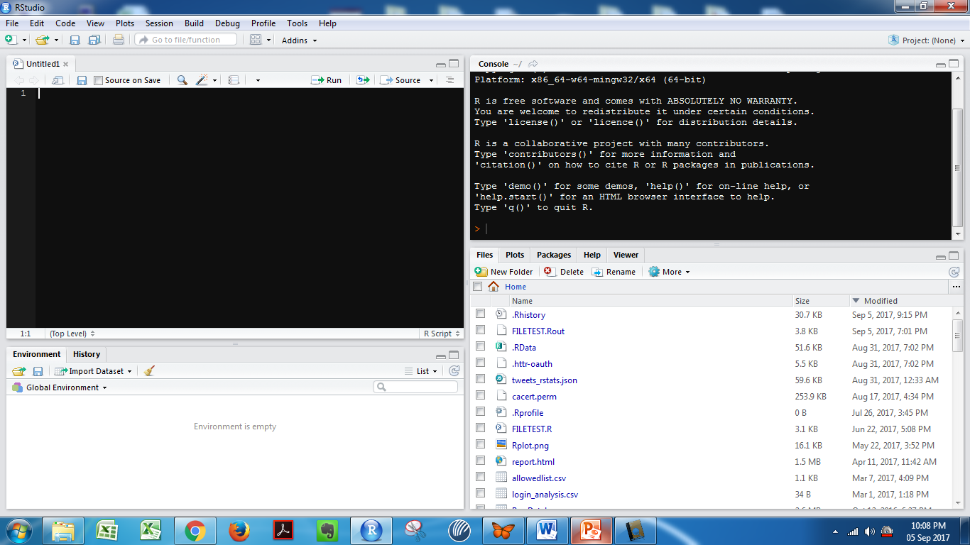
Overview of RStudio

Slide 15
RStudio ...
Shortcuts
Recommended settings
Project
Working directory

Slide 16
R Packages
Install R package
Load R package
libraries are installed at . libPaths()

Slide 17
Define Variables
Variables can be defined with <- or =
Use of <- is recommended
Remember - R is case sensitive
Recommended “snake_case”
It cannot be just any number
Variable name should not begin with a number or special character

Slide 18
R Data Class
Numeric
Integer
Logical
Character
Complex
Raw
Use Class to identify data type

Slide 19
R Data Structure
Vector
Matrix
Data Frame
List
Arrays
Use str, head, tail or glimpse
Observation and variable
Notes:
str(cars)

Slide 20
Additional Data Types
Tibble
ts
xts
zoo
transactions
etc

Slide 21
Factor

Slide 22
Subset

Slide 23
Indexing

Slide 24
Dim
Nrow
Ncol
Colnames

Slide 25
BASIC OPERATIONS
Arithmetic Operations
“+”, “-”, “/”, “*”, “%%”
Logical Operations
“&”, “|”, “&&”, “||”
Relational Operation
“==“, “!=“, “<“, “>”, “<=“, “>=“

Slide 26
Exercise

Slide 27
The pipe operator (magrittr)
Data
Operation
Operation
%>%

Slide 28
Pipe Exercise

Slide 29
Save and source file

Slide 30
THE IF ELSE STATEMENT
Ifelse(logic, if true, if false)
if ( logic ) {
expression
} else {
expression
}

Slide 31
THE IF ELSE …. (Continue)
if ( logic ) {
expression
} else if {
expression
} else {
expression
}

Slide 32
Lets form a Loop
for ( variable in sequence ) {
expression
}
For loop over a list
#break with if
#next with if

Slide 33
Loop…continue
while ( condition ) {
expression
#usually increase the condition
# use break to break the loop
}

Slide 34
If and Loop Exercise

Slide 35
Help?

Slide 36
SEC 3 – R Base Charts in R
Basic charts in R
Multiple plots on one chart
Chart parameters - line width, line type, color, shape etc

Slide 37
Basic Charts in R

Slide 38
Scatter plot
library(MASS)
plot(medv ~ rm, data = Boston)

Slide 39
Sunflower Plot
sunflowerplot(Petal.Width ~ Petal.Length, data = iris, cex = .2, cex.fact = 1, size = .035, seg.lwd = .8)

Slide 40
Bar plot

Slide 41
Line chart

Slide 42
Box Plot
library(MASS)
boxplot(crim ~ rad, data = Boston, log = "y", las = 1, xlab = "rad")
title("Variation of Boston$crim values over discrete Boston$rad values")

Slide 43
Multiple Plots
par(mfrow = c(1, 2))
plot(iris$Species, iris$Sepal.Length)
plot(iris$Sepal.Length, iris$Sepal.Width)

Slide 44
Add points, line, text
After plot
Points(c(1,2,3,), UScereal$fibre[index], pch = 16, col = "red")
lines(density(geyser$duration), lwd = 2, col = "blue")
text(65, 23, “text", adj = 1, col = "red")

Slide 45
Title, labels, legend
Just below chart add
Title(“the title”)
Labs(x = “xlabel”, y = “ylabel”)
legend("topright", pch = c(1, 16), legend = c("Before insulation", "After insulation"))

Slide 46
options(DT.options = list(pageLength = 5))

Slide 49
Instructions for use
EDIT IN GOOGLE SLIDES
Click on the button under the presentation preview that says "Use as Google Slides Theme".
You will get a copy of this document on your Google Drive and will be able to edit, add or delete slides.
You have to be signed in to your Google account.
EDIT IN POWERPOINT®
Click on the button under the presentation preview that says "Download as PowerPoint template". You will get a .pptx file that you can edit in PowerPoint.
Remember to download and install the fonts used in this presentation (you’ll find the links to the font files needed in the Presentation design slide)
More info on how to use this template at www.slidescarnival.com/help-use-presentation-template
This template is free to use under Creative Commons Attribution license. You can keep the Credits slide or mention SlidesCarnival and other resources used in a slide footer.

Slide 50
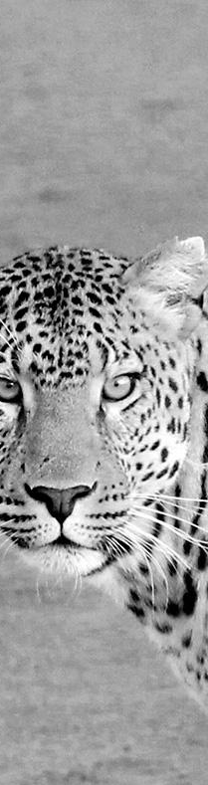
Hello!
I am Jayden Smith
I am here because I love to give presentations.
You can find me at:
@username

Slide 51
Quotations are commonly printed as a means of inspiration and to invoke philosophical thoughts from the reader.

Slide 52
This is a slide title
Here you have a list of items
And some text
But remember not to overload your slides with content
Your audience will listen to you or read the content, but won’t do both.

Slide 53
Big concept
Bring the attention of your audience over a key concept using icons or illustrations

Slide 54
You can also split your content
White
Is the color of milk and fresh snow, the color produced by the combination of all the colors of the visible spectrum.
Black
Is the color of coal, ebony, and of outer space. It is the darkest color, the result of the absence of or complete absorption of light.

Slide 55
In two or three columns
Yellow
Is the color of gold, butter and ripe lemons. In the spectrum of visible light, yellow is found between green and orange.
Blue
Is the colour of the clear sky and the deep sea. It is located between violet and green on the optical spectrum.
Red
Is the color of blood, and because of this it has historically been associated with sacrifice, danger and courage.

Slide 56

A picture is worth a thousand words
A complex idea can be conveyed with just a single still image, namely making it possible to absorb large amounts of data quickly.

Slide 57
Want big impact?
Use big image.

Slide 58
Use charts to explain your ideas
White
Gray
Black

Slide 59
And tables to compare data
 | A | B | C
Yellow | 10 | 20 | 7
Blue | 30 | 15 | 10
Orange | 5 | 24 | 16

Slide 60

Maps
our office

Slide 61
89,526,124
Whoa! That’s a big number, aren’t you proud?

Slide 62
89,526,124$
185,244 users
100%
That’s a lot of money
And a lot of users
Total success!

Slide 63
Our process is easy
First
Second
Last

Slide 64
Let’s review some concepts
Yellow
Is the color of gold, butter and ripe lemons. In the spectrum of visible light, yellow is found between green and orange.
Blue
Is the colour of the clear sky and the deep sea. It is located between violet and green on the optical spectrum.
Red
Is the color of blood, and because of this it has historically been associated with sacrifice, danger and courage.
Yellow
Is the color of gold, butter and ripe lemons. In the spectrum of visible light, yellow is found between green and orange.
Blue
Is the colour of the clear sky and the deep sea. It is located between violet and green on the optical spectrum.
Red
Is the color of blood, and because of this it has historically been associated with sacrifice, danger and courage.

Slide 65
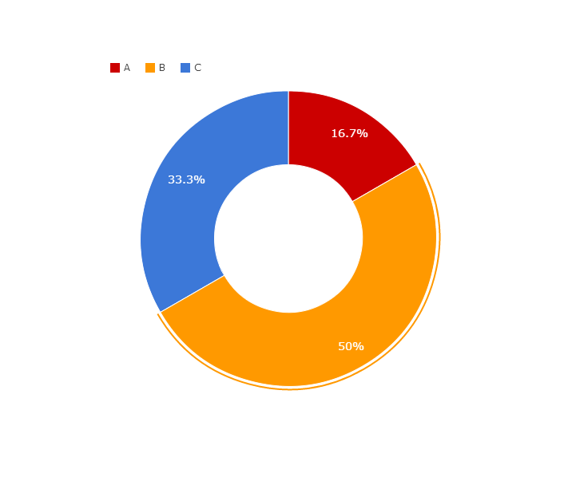
You can copy&paste graphs from Google Sheets

Slide 66
Android project
Show and explain your web, app or software projects using these gadget templates.
Place your screenshot here

Slide 67
iPhone project
Show and explain your web, app or software projects using these gadget templates.
Place your screenshot here

Slide 68
Tablet project
Show and explain your web, app or software projects using these gadget templates.
Place your screenshot here

Slide 69
Place your screenshot here
Desktop project
Show and explain your web, app or software projects using these gadget templates.

Slide 70
Thanks!
Any questions?
You can find me at:
@username
user@mail.me

Slide 71
Credits
Special thanks to all the people who made and released these awesome resources for free:
Presentation template by SlidesCarnival
Photographs by Unsplash

Slide 72

Presentation design
This presentations uses the following typographies and colors:
Titles: Raleway
Body copy: Lato
You can download the fonts on this page:
https://www.google.com/fonts#UsePlace:use/Collection:Lato:400,700,400italic,700italic|Raleway:400,700
Click on the “arrow button” that appears on the top right
Dark blue #2185c5
Light blue #7ecefd
Yellow #ff9715
Magenta #f20253
Dark gray #677480
Light gray #97abbc
You don’t need to keep this slide in your presentation. It’s only here to serve you as a design guide if you need to create new slides or download the fonts to edit the presentation in PowerPoint®

Slide 73
SlidesCarnival icons are editable shapes.
This means that you can:
Resize them without losing quality.
Change fill color and opacity.
Change line color, width and style.
Isn’t that nice? :)
Examples:

Slide 74
😉
Now you can use any emoji as an icon!
And of course it resizes without losing quality and you can change the color.
How? Follow Google instructions https://twitter.com/googledocs/status/730087240156643328
✋👆👉👍👤👦👧👨👩👪💃🏃💑❤😂😉😋😒😭👶😸🐟🍒🍔💣📌📖🔨🎃🎈🎨🏈🏰🌏🔌🔑 and many more...

